Slide 1
Analysis of Algorithms
Introduction
Mariha Asad

Slide 2
Algorithm
An algorithm is a procedure that takes some values, or set of values, as input and produces some value, or set of values, as output.
An algorithm is thus a sequence of steps that transform the input into output.
A good understanding of algorithms is essential for a good understanding of the most basic element of computer science: programming.

Slide 3
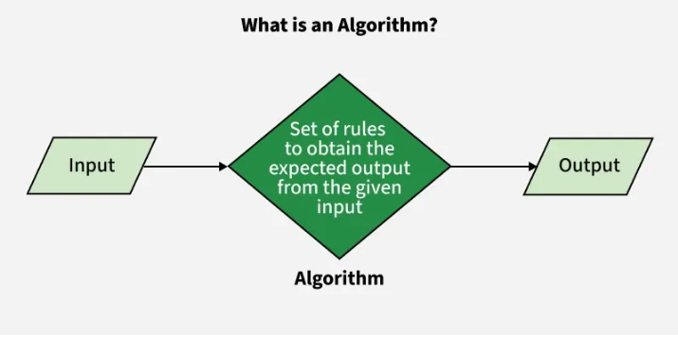
Algorithm
An algorithm is a mathematical entity, which is independent of a specific programming language, machine, or compiler.

Slide 4
Why study algorithm?
To manage the time complexity
For efficiency
Some software/algorithms contains some complex portion (may be 10 or 100 lines) but they consume more time
80% of the execution time takes place in 20% of the code
Our purpose is best to deal with these complex portions
It may be very important for the success of the overall project that these sections of code be written in the most efficient manner possible.
We want to design good algorithms

Slide 5
Properties of Algorithm
Clear and un ambiguous
Well defined inputs
Well defined outputs
Finite-ness
Feasible
Language independent

Slide 6
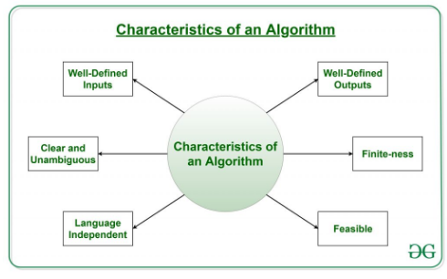

Slide 7
Properties of Algorithm
Clear and Unambiguous
  Each of its steps should be clear in all aspects and must lead to only one meaning
Well-Defined Inputs
  It should be well-defined inputs
  It may or may not take input
Well-Defined Outputs
  It should produce at least 1 output

Slide 8
Properties of Algorithm
Finite-ness
  It should terminate after a finite time
  Infinite loops and recursion without base condition do not produce finite algorithms
Feasible
  The algorithm must be simple, generic, and practical
  It can be executed with the available resources
Language Independent
  It must be just plain instructions that can be implemented in any language

Slide 9
Thanks

